Slide 1


Nearly Natural- Value Stream
Prepared by CPQP
Confidential for Robbie Singer Only

Slide 2

Value Stream Mapping
Material Handling
Manufacturing
Shipping
Receiving
In-Bound Goods Process
Inventory Control
In-Bound Material Put-A-Way
Manufacturing Put-A-Way
Cycle Counting
Inventory Replenishment/ Forward Zone Replenishment
Un-Boxing (AKA: De-Containing)/Secondary
Production Prep
Un-Boxing (AKA: De-Containing)/Primary
Postproduction
1. Material Storage
Shipping by Function
The Pick Module
Bulk Shipping
Amazon/Home Goods

Slide 3
Value Stream Event Schedule

Slide 4

Material Handling

Slide 5
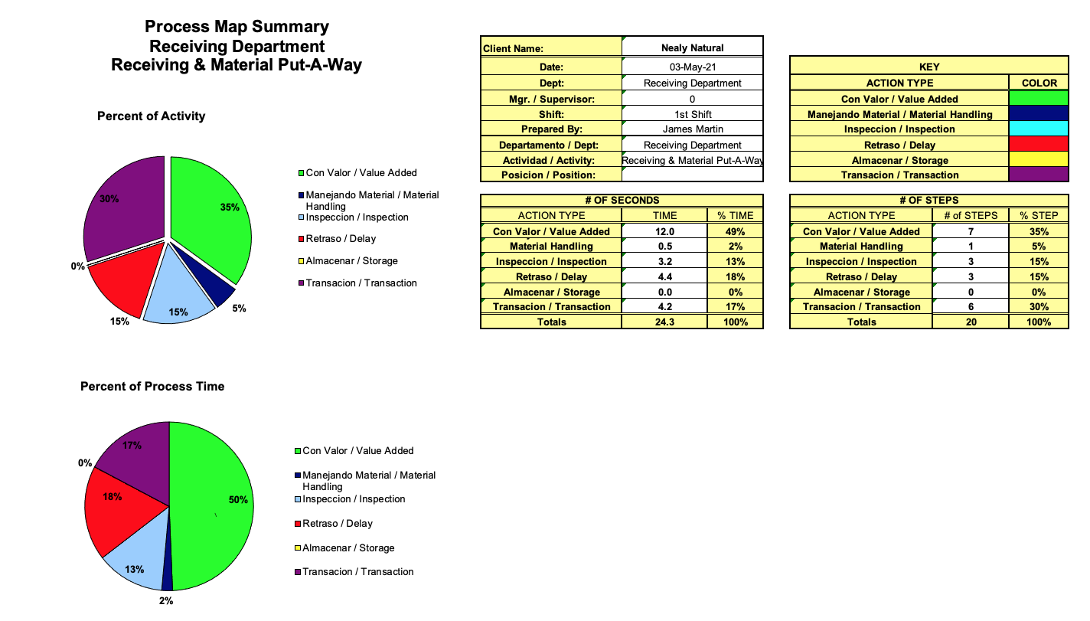
Receiving & Material Put-A-Way
Current State
Observations
Associates
  Two - Pallet Builders
  One - Container Person
  One - Bin Transfer Person
Preparation & Process
  Placing empty pallets into position
  Staging empty pallets closer to the receiving station
  Misc. equipment: Tape, Shrink-wrap, etc.
  The team spends too much time organizing the pallets (Squaring)
Associate Skill Sets
  The team lacks focus and drive
  The team is more focused on random chatter then the work
The Leadership Team
  The team lacks direct leadership
  The receiving manager is more of a coordinator then as a manager
Process Time
Pallet Building (Avg) – 8.25 per pallet
Put-A-Way (Avg) – 8.30 per pallet

Slide 6
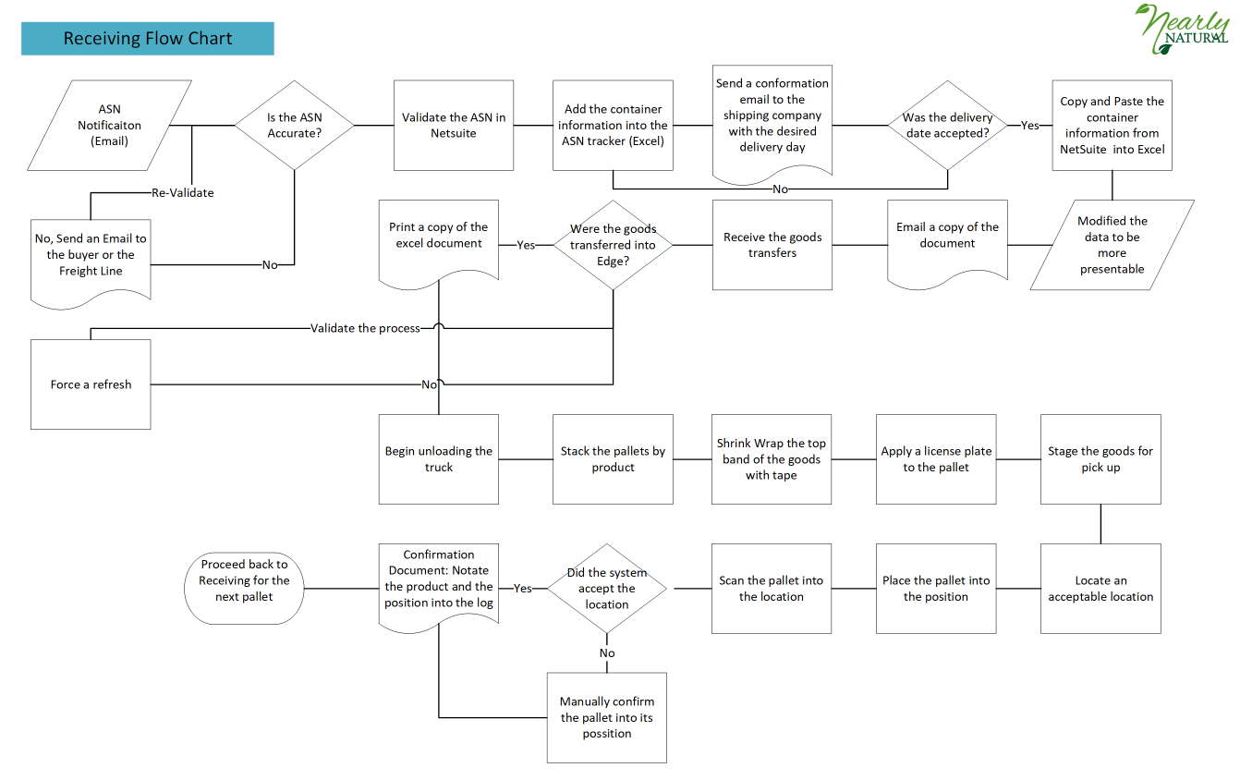
Receiving & Material Put-A-Way
The Process Flow
Current State

Slide 7
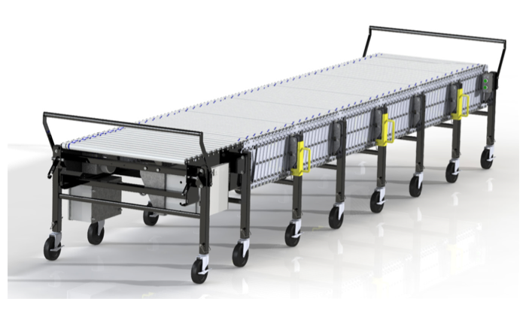


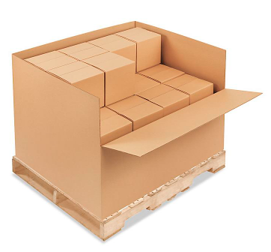
Receiving & Material Put-A-Way
Future State 1.0
Enhancements
Motorized Conveyor
Bay Door
Associates
Eliminate the bin transfer position
Add an additional material handler
Area Optimization
Fill the Empty pallets from front to back
Staging pallets
Relocate the two forklift charging areas
Create a workstation
  Printer
  Label Printer
  Misc. Office Supplies
  Shrink Wrap with Dispenser
  Tape
Utilize gaylord boxes for storage
  $18-22 per box vs $200 per cage
Institute zone replenishment
Remove the waste!
KPI Requirements
Increase from Two Conex per day to three
End of Shift Checklist
Closed Receipt reporting
System Enhancements
Open pallet position reporting
WS
P6
P5
WS
PX
P4
P3
PX
PX
P2
P1
PX
New Storage Platform
Desired Output
The pallet building process is reduced by 50%
The # of pallets put-a-way is increased by 100%
The # of containers unloaded is increased by 33%
Key
P1-P6 - Pallet Positions
PX - Pallet Exchange
WS– Workstation
Green – Motorized Conveyor
Blue Arrows: Movement
Notes:
https://northamcon.com/wp-content/uploads/2019/05/POWER-FLEX-MANUAL-ENGLISH_200085_Rev4.pdf

Slide 8
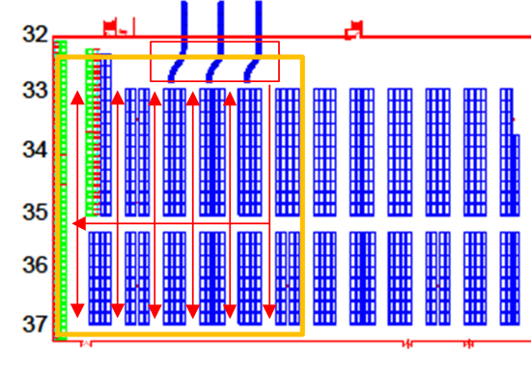
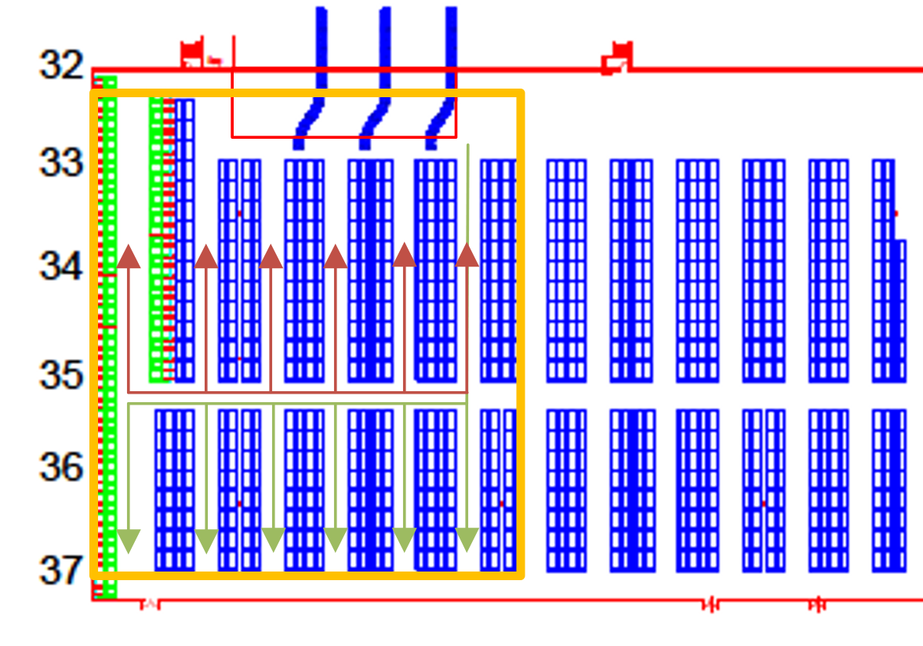
Receiving & Material Put-A-Way –
The Process Flow
Current State vs. Future State

Slide 9

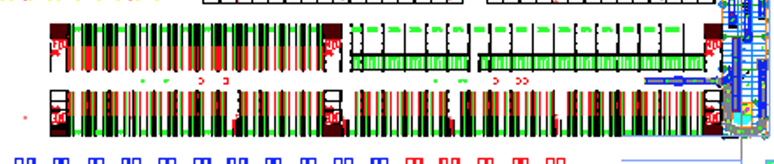
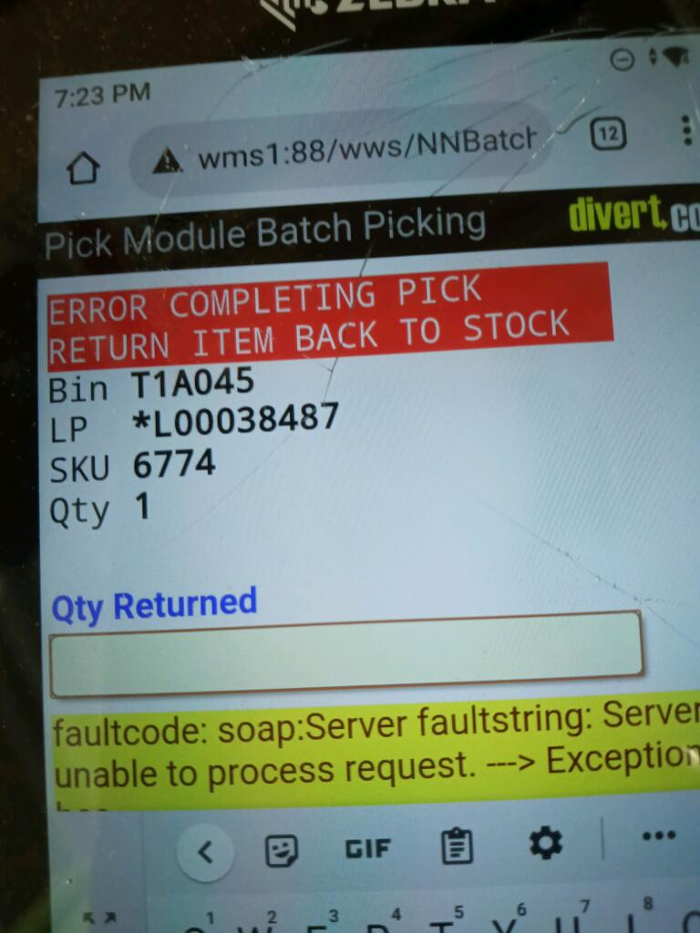
The Pick Module
Current State
Observations
S
E
W
Layout
  The general placement of the PM causes a flow hindrance for the entire facility
  A new vehicle flow needs to be considered
Capacity
  The overall capacity of the system is underutilized
  A SKU rationalization is required
Associates
  Three- Material Handlers
  One- Consolidator (Recently Hired)
Preparation & Process
  Multiple empty position & empty pallets
  Multiple single or few products located on a pallet which could be consolidated
  Damaged aisles
  Lots of trash
Associate Skill Sets
  Ruben seemed to be the most knowledge and he’s able to drive a forklift
  Additional training is need for the two other associates
The Leadership Team
  The team lacks direct leadership
  An order coordinate is needed
System Issues
  Picking issues: The associate would stage their pick, but when they attempt to proceed the system receive an error message and the associate must return the products to the designated license plate
  2. Missed or Miss applied shipping labels
N
Damaged Sections

Slide 10
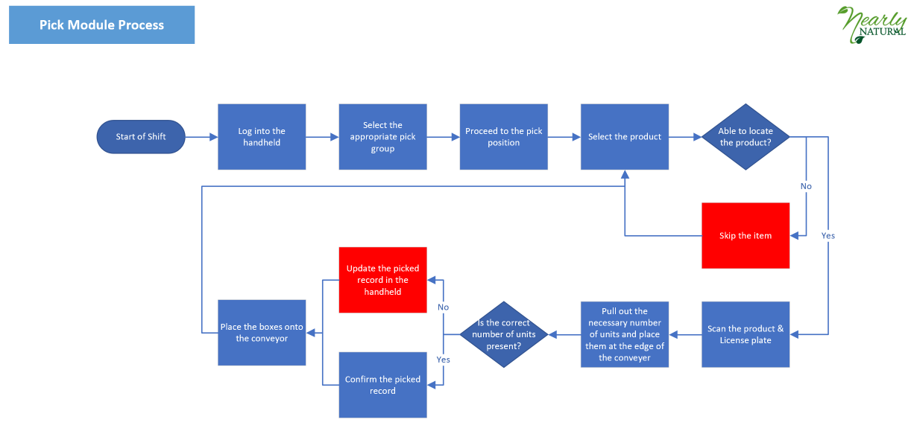
Pick Module- Process Flow

Slide 11
The Pick Module
Future State 2.0
PM
Direct Manufactured Goods
C Zone
X Zone
The Other Warehouse
Enhancements
System
  Setup direct replenishment from the production line to the PM
  Setup specific bin locations for the fast-moving products (Multiple child locations)
  Enable multiple locations to replenish to the PM
  Enable the consolidating position to also handle minor cycle counts (Set a maximum adjustment ceiling: $250)
  Require for each package to be scannable
  Change the pick to ship sequence (Next Slide)
  Add three hip printers to each level for bar code replacements
  Enable smalls outbound packages to be shipped out via the PM
Associates
  Additional system training
  The associates need to be provided with a tool for reporting any system related errors
  Headcount:
    Two- Consolidators
    One-Pallet Consolidator
    Three- Pickers

Slide 12
The Pick Module
Future State 2.0
The Pick Process 1.0
The Logic
Locate
Count
Stage
Scan
Ship
Reduction in Process Steps
Labor Inefficiencies Reduction
Productivity Increase in other departments
Eliminate System Process Errors
2.0
Increased Inventory Accuracy
The Pick Process 2.0
Locate
Scan/Count
Ship

Slide 13
The Pick Module “ER”
Current to Future
Phase 1 (May 19th to Fixed)
Validate the current SKU’s
Run the manual replenishment report Daily by 8:00 AM
Schedule transfers from E to PM “Manually”
Hire Two Consolidators
Hire One Additional Replenisher
Phase 2 (May 24st to Fixed)
Validate the PM product Offering – Are we stocking the right products?
Set up the new mother/baby pathways
Implement a bi-weekly sales to stock confirmation process by Sku

Slide 14
Org Changes- Main Facility
Pick Module Replenishment
2 Shifts: Shifts 1 and 3
Shifts
Shift 1: 4:00 AM to12:30 PM
Shift 2: 7:00 AM to 3:30 PM
Shift 3: 3:30 PM 12:00 PM
Cycle Counts
Skipped Picks –Shift 2
Physical Counts – Shift 3
Receiving
Shifts 1 and 3

Slide 15
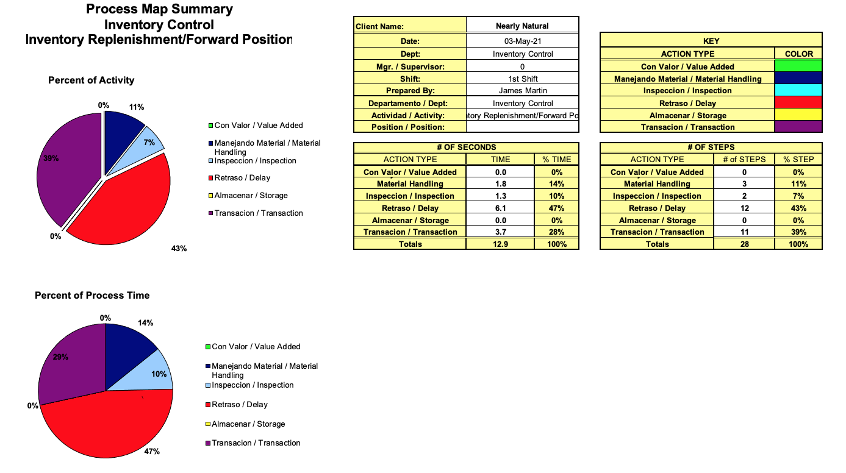
Inventory Control: Forward Replenishment
Current State
Observations
Associates
  One IC Associate (Shadowed)
Preparation & Process
  Two systems: A personal text message and the WMS system
  Due to congestion in the aisle the associate was delayed multiple times
  Noted several inventory inaccuracies
Associate Skill Sets
  The associate understands his role and has a decent knowledge about the system
The Leadership Team
  NA

Slide 16
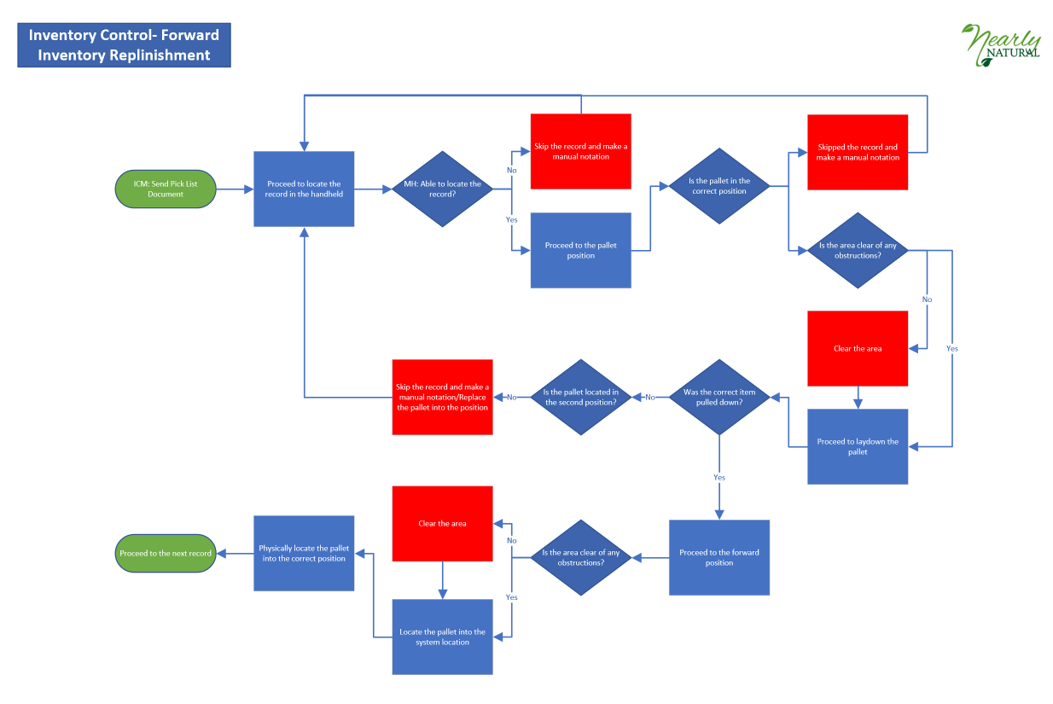
Inventory Control: Replenishment Process Flow
Current State

Slide 17
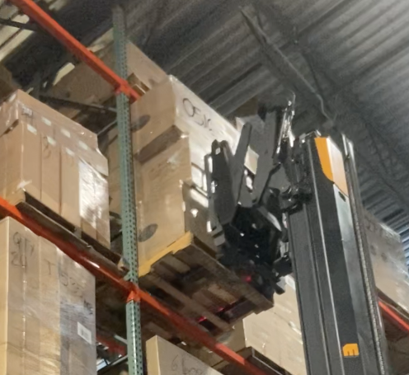
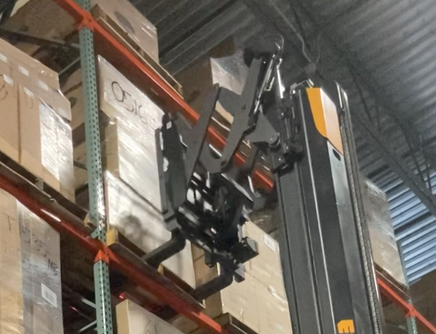
Inventory Control: Replenishment
Future State 2.0
Enhancements
System
  The pick groups need to be assigned to the user via the handheld, and not by a text message
  Each associate should be assigned to a particular zone
Additional Requirements
  A zone physical needs to be completed
  The aisle need to be clear of any obstructions
  Need to transition from the manual paper logs into a digital format
Rules of Engagement
  Always push the pallet position backwards
  The aisles need to remain clean and clear

Slide 18

Manufacturing

Slide 19
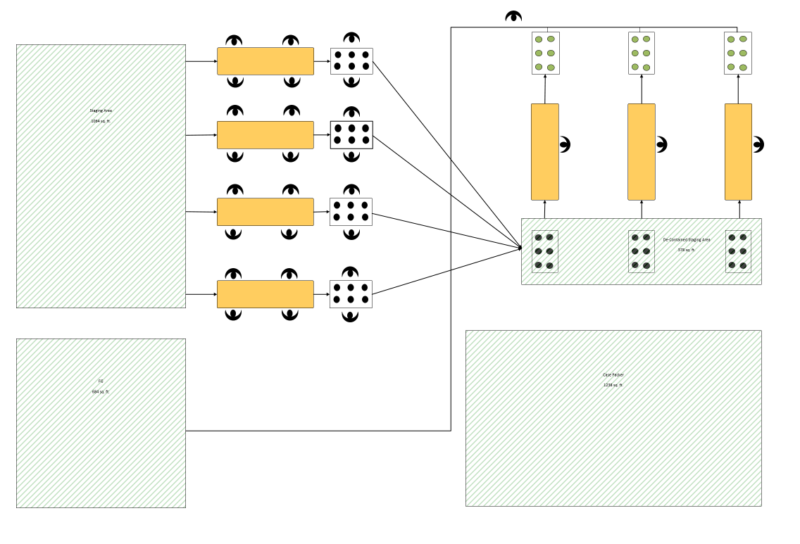
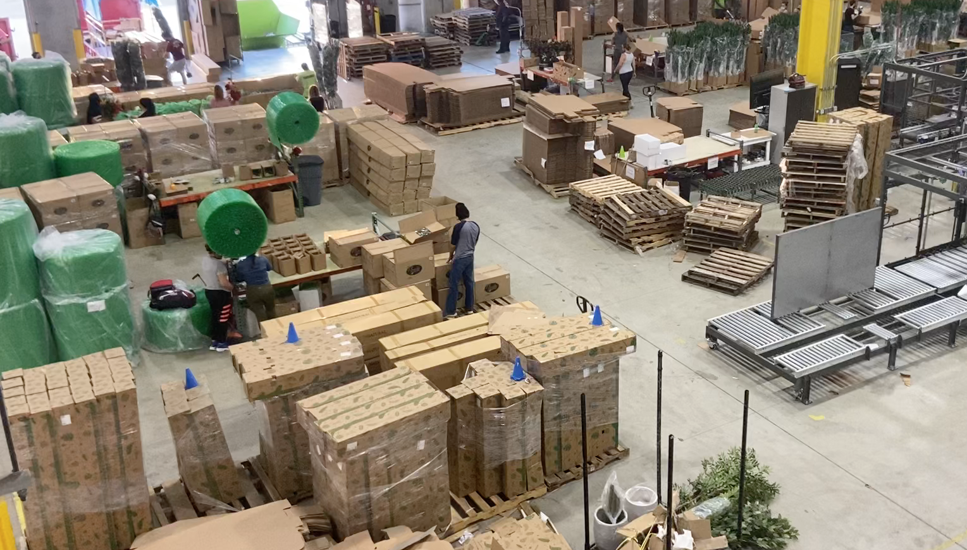
De-Containing: Primary Area
Current State
Observations
Associates
  Primary Area:
    De-Containing: 16
    Bin Loaders: 8
    Material Handlers: 2
    Trash Management: 2
Preparation & Process
  Workflow inconsistences
  Too many process steps
  The cycle time in between certain processes isn’t consistence with the next process step = A bottleneck
Associate Skill Sets
  High labor/Low skill sets
The Leadership Team
  The female lead is attempting to manage the chaos
Stage
Unbox
Wrap
Stage
Transport
Case Erection
Re-Pack
Seal
Stage
Transport to FG

Slide 20
De-Containing: Primary Area
Future State 2.0

Slide 21
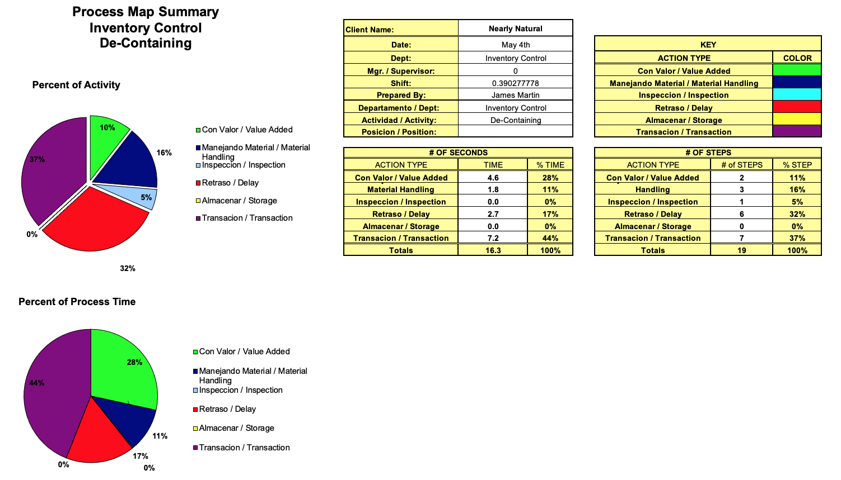
De-Containing: Secondary Area
Current State
Observations
Associates
  Secondary Area:
    De-Containing: 4
Preparation & Process
  Purpose: De-Contain the master packages for replenishment
Associate Skill Sets
  Each associate need additional training
  Low skill set, Medium Labor
  Cycle Time: 16.3 minutes per pallet
The Leadership Team
  Throughout the week, Julio provided some additional training

Slide 22
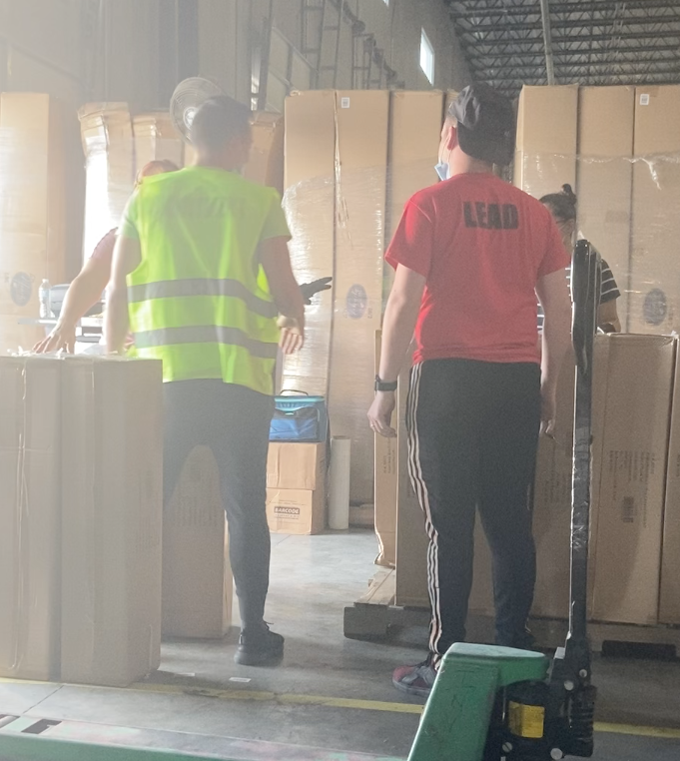
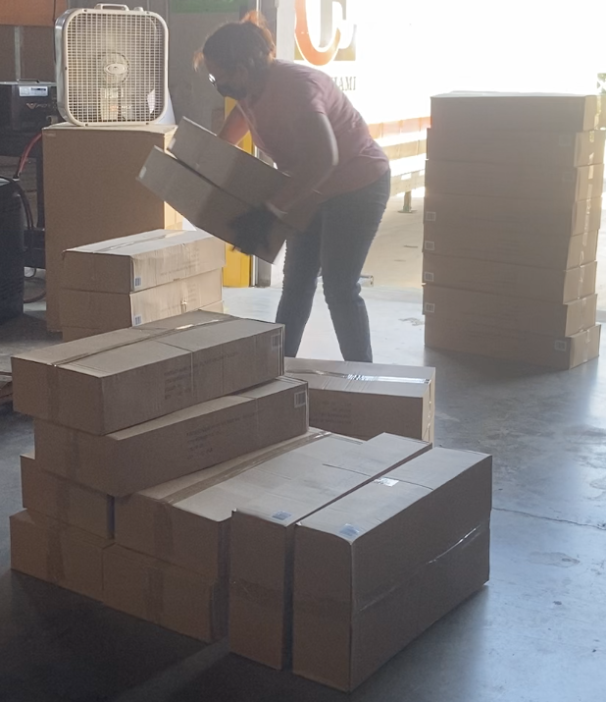
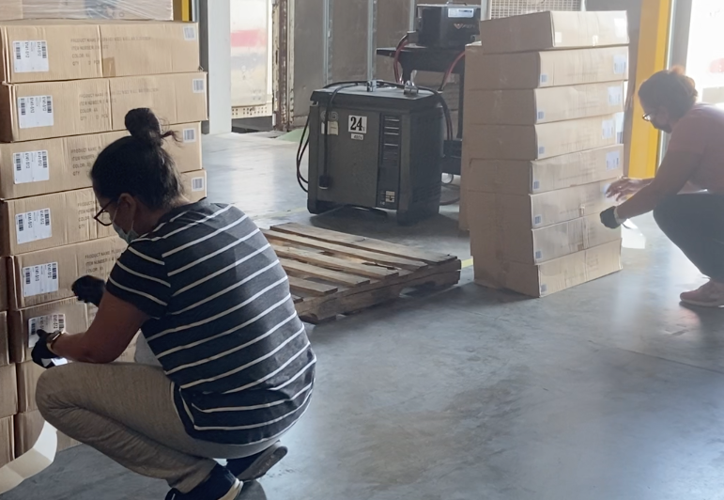
De-Containing: Secondary Area
Current State
How to confuse a computer program
Training Support
How to build an Empire?
Left Side
Where should it go?
Over the existing Bar Codes
Right Side

Slide 23
De-Containing: Secondary Area
Future State 2.0
Enhancements Option 1
Enhancements Option 2
Concept
  Transition this function to the primary De-Containment Area
Justification
  Maximize the number of available resources
  Provide direct supervisor
  Reduce the travel distance to the PM
  Provide additional space in the receiving area
Potential Setbacks
  Potential resource schedule conflicts
    Production vs. Replenishment
  Additional traffic congestions
Concept
  De-Contain directly from the Conex trailer
  Master packages with non-exposed goods
Justification
  Removes several process steps
  Faster replenishment to the PM
  Increases the C zone capacity
Potential Setbacks
  Increases the receiving process time
  Requires additional staging space in receiving
  Additional traffic congestions
  Requires additional direct supervision
HR Synergy
Capacity Optimization

Slide 24
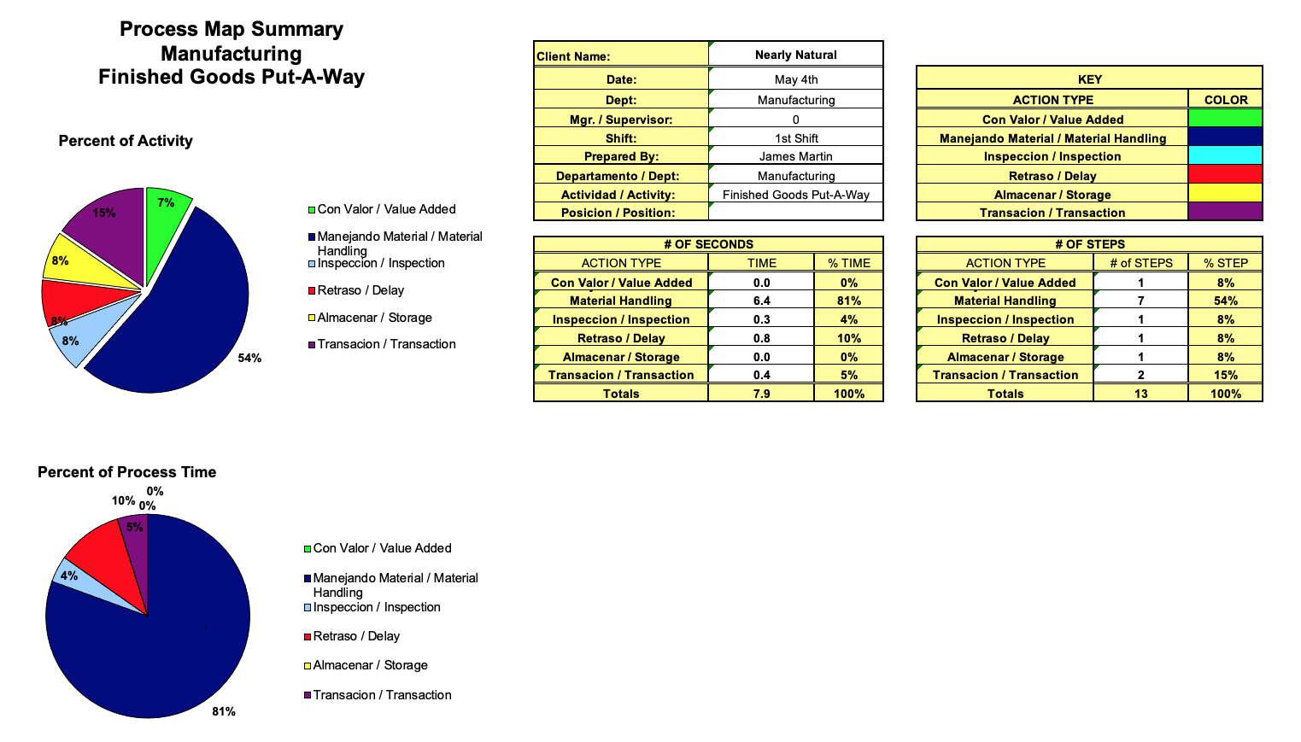
Manufacturing- FG Put-A-Way Process
Current State
Observations
Associates
  Two In-Flow Material Handlers
  Two Out-Flow Material Handers
Preparation & Process
  Inflow outpaces the Outflow
  The staging area is a flow bottleneck
  High travel area (Main Artery Point)
  The main travel path is not setup for multiple forklifts (11 FT. vs. 12 FT. (OSHA))
Associate Skill Sets
  IF- Steady/High Labor/Low Skill Sets
  OF-Distracted/Low Labor/Medium Skill Set
The Leadership Team
  Zero to limited interaction by the management team
Staged inventory (Unknown)
IF/FG
~2 min.
OF/FG
~ 5 min.

Slide 25
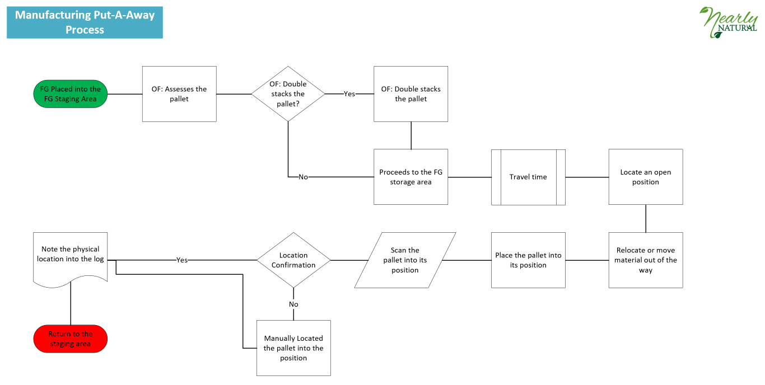
Manufacturing- GF Put-A-Way Process Flow
Current State

Slide 26
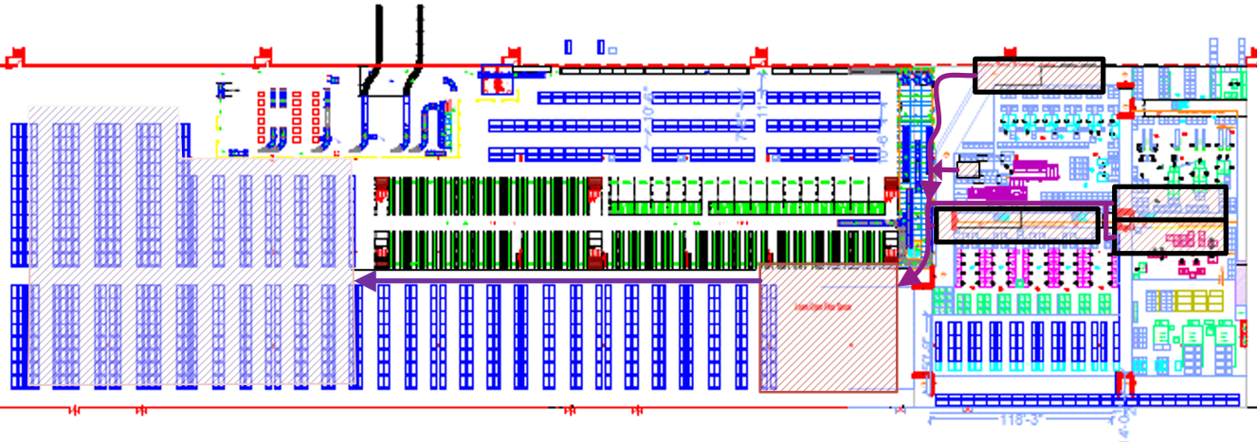
Manufacturing- GF Put-A-Way Process
Current State

Slide 27
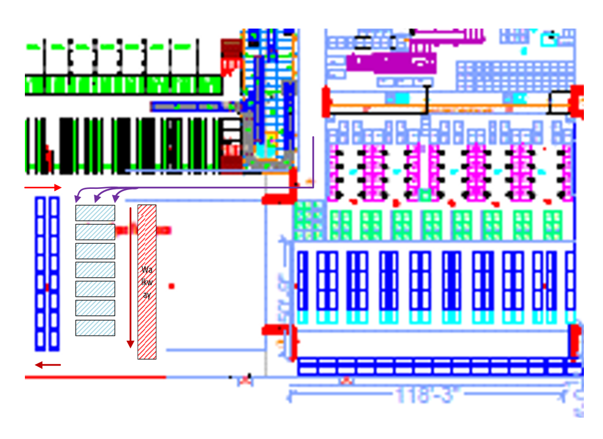
Manufacturing- GF Put-A-Way Process
Future State 1.0
Enhancements
Associates
Two Options
Add one additional associate
Always travel with double stacked pallets
Preparation & Process
Relocated the FG storage area
Turn the lanes by 90 degrees
Change the material flow
  Up-flow only = The Main Aisle
  Down-flow only = The East Wall
System Enhancements
1) Install and test directive put-a-way

Slide 28
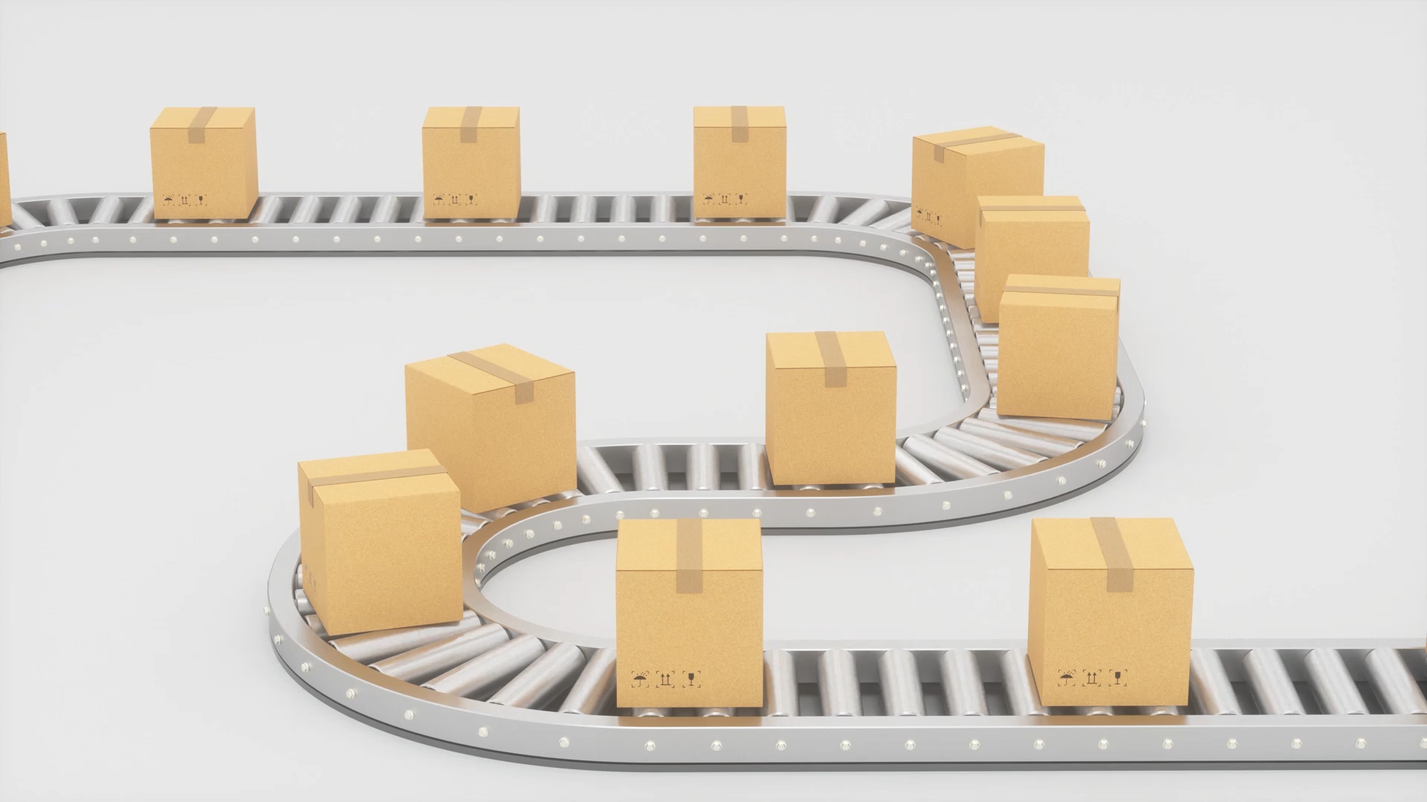
Shipping

Slide 29

Next Steps

Slide 30
Long Term View
Material Handling
Manufacturing
Shipping
Reduce the number of process steps
Maximize the current capacity
Reduce the number of redundant material positions
Staggered employee schedules
Order Additional Material Handling Equipment
Display the KPI requirements and results
Production Based Planning
  Stage what’s going to be built
Implement a two-week production schedule
Create a 24 hrs. or less production area
Balance the operational needs by functional area
Shipped Billing Confirmation
Relocate Amazon/HG to the north of the shipping office
Training and role documentation guides
Other
Forklift Charging Farm
Number of Hot Rush Item transfer per day

Slide 31
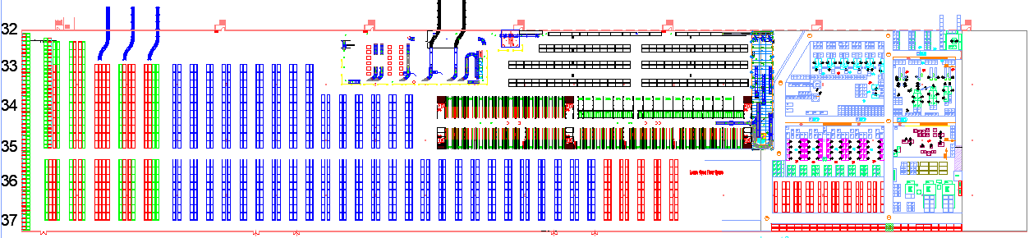
Facility Layout
Future State 2.0
Amazon & Home Goods Finished Goods
Forward Staging for Foaming/De-Containing & X- Zone
Bulk Storage
X- Zone
Forward Staging for Liquid and Decorative Flowers
Finished Goods Staging

Slide 32
Appendix

Slide 33
Additional Observations
Observation | Description | Corrective Action
 | Management's interaction and knowledge about the overall processes
 | Private Labeling | Why?

